Slide 1
A preliminary study on empirical analysis of conducted EMI from electrical appliances
Ver1.3
25-03-2014

Slide 2
Short forms and considerations
BGN: Background noise
PLL: Power load line meant for 15Amp loads
By default the frequency range is from 10Khz-1Mhz unless defined explicitly.

Slide 3
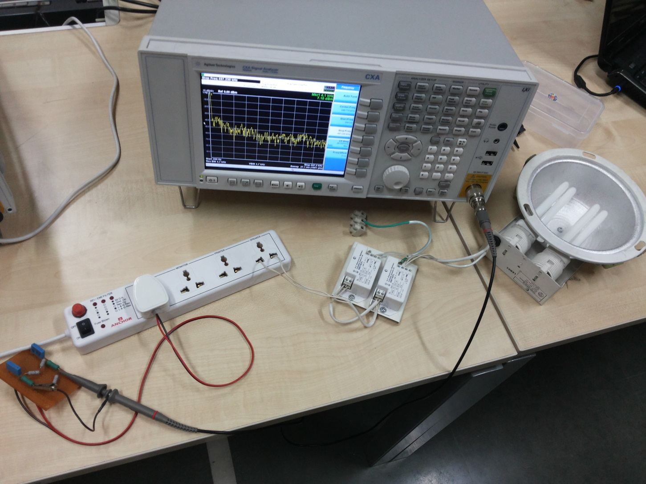
Hardware Setup for < 5Amp loads

Slide 4
Hardware Setup: EMI sensing
Signal Analyser
9.0Khz-7.5Ghz
Agilent N9000A
Mains Power
Supply
HPF
Extension Cord
Mains Power
Supply
EMI
Filter
Appliance-1
Appliance-1
Appliance-3

Slide 5
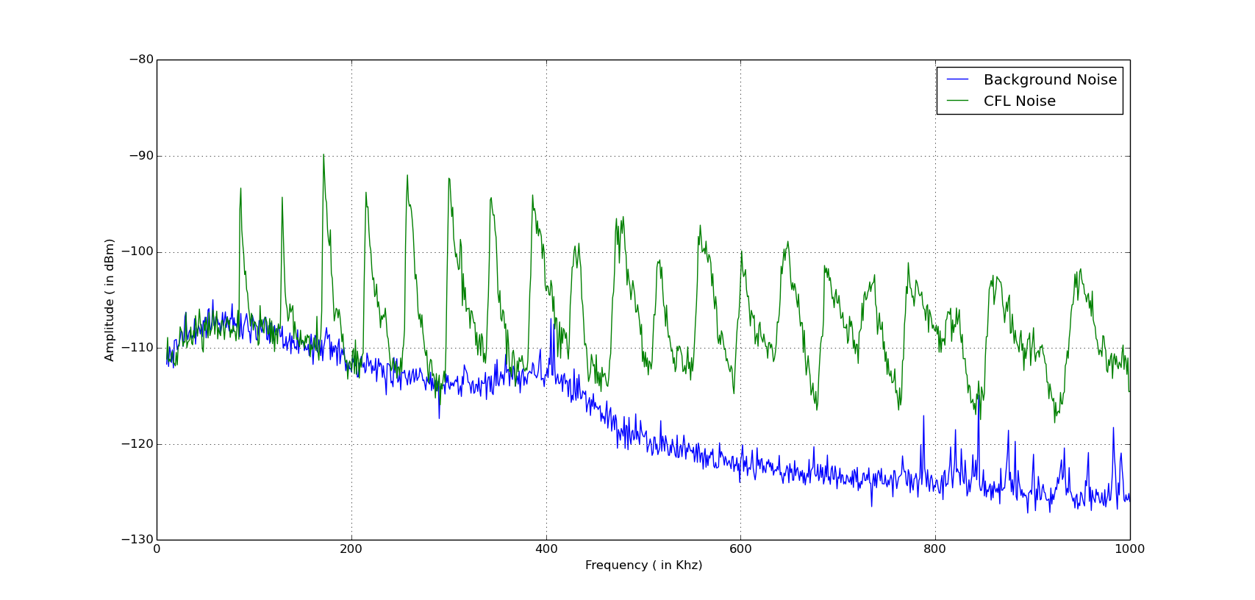
Noise from CFL and BGN

Slide 6
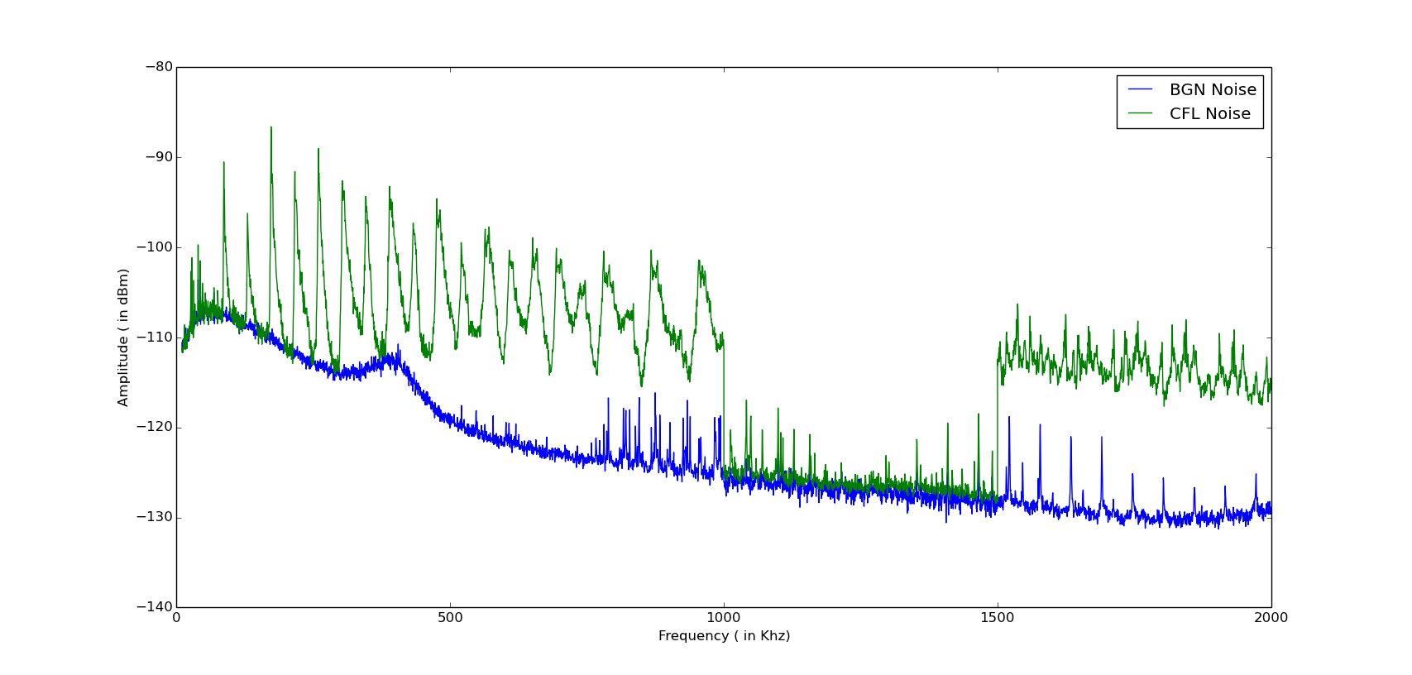
Noise from CFL and BGN

Slide 7
Observations
EMI noise is quite significant from 60Khz and stays for long.
Amplitude goes down from -90dBm to -100dBm with higher frequencies.
Even amplitude of harmonics is significant enough -100dBm.
In freq. range 600Khz - 1Mhz Vmin of noise amplitude is roughly 10dB higher then baseline noise.
Not very much sure but a slightly low cut-off HPF may give some more information in LF range.

Slide 8
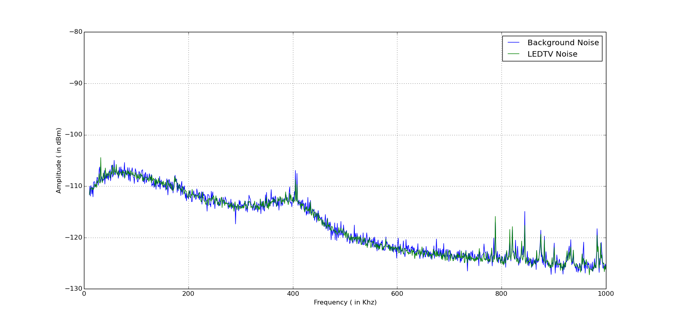
Noise from LEDTV and BGN

Slide 9
Observations
EMI noise is completely suppressed by inbuilt EMI filter in current freq. range from 10hz to 1Mhz.
Hardly any change is noticed in visible spectrum.

Slide 10
Noise from CFL and BGN

Slide 11
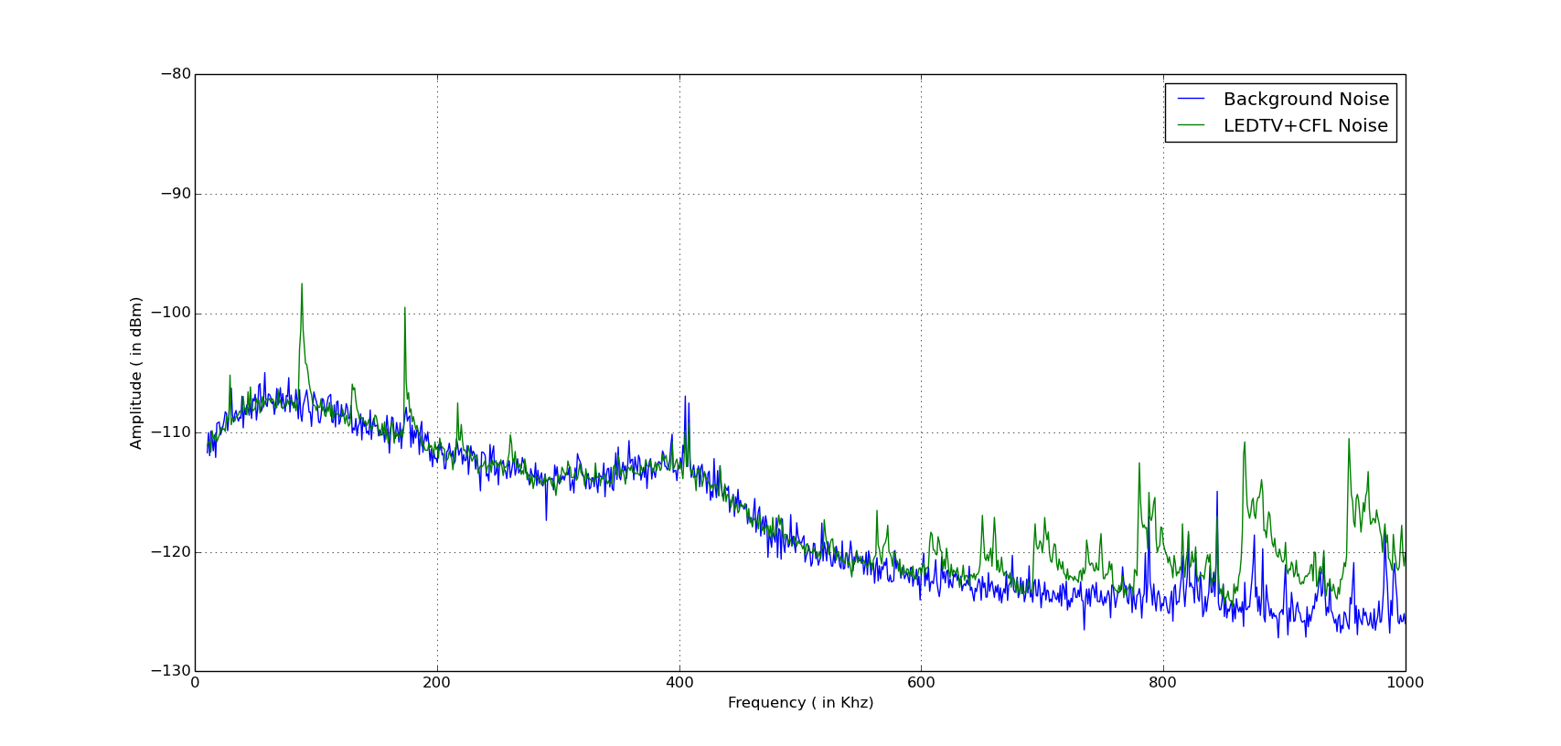
Noise from LEDTV+CFL and BGN

Slide 12
Observations
Current combination of LEDTV and CFL gave some nice results.
For ease of comparison same trace of CFL is copied above.
EMI noise is completely suppressed from 200Khz to 550Khz.
Amplitude of EMI noise(CFL) from 550KHz to 1Mhz is reduced by 10dB.
Similar was case for EMI from 10Hz to 200Khz range amplitude reduced by 10dB.

Slide 13
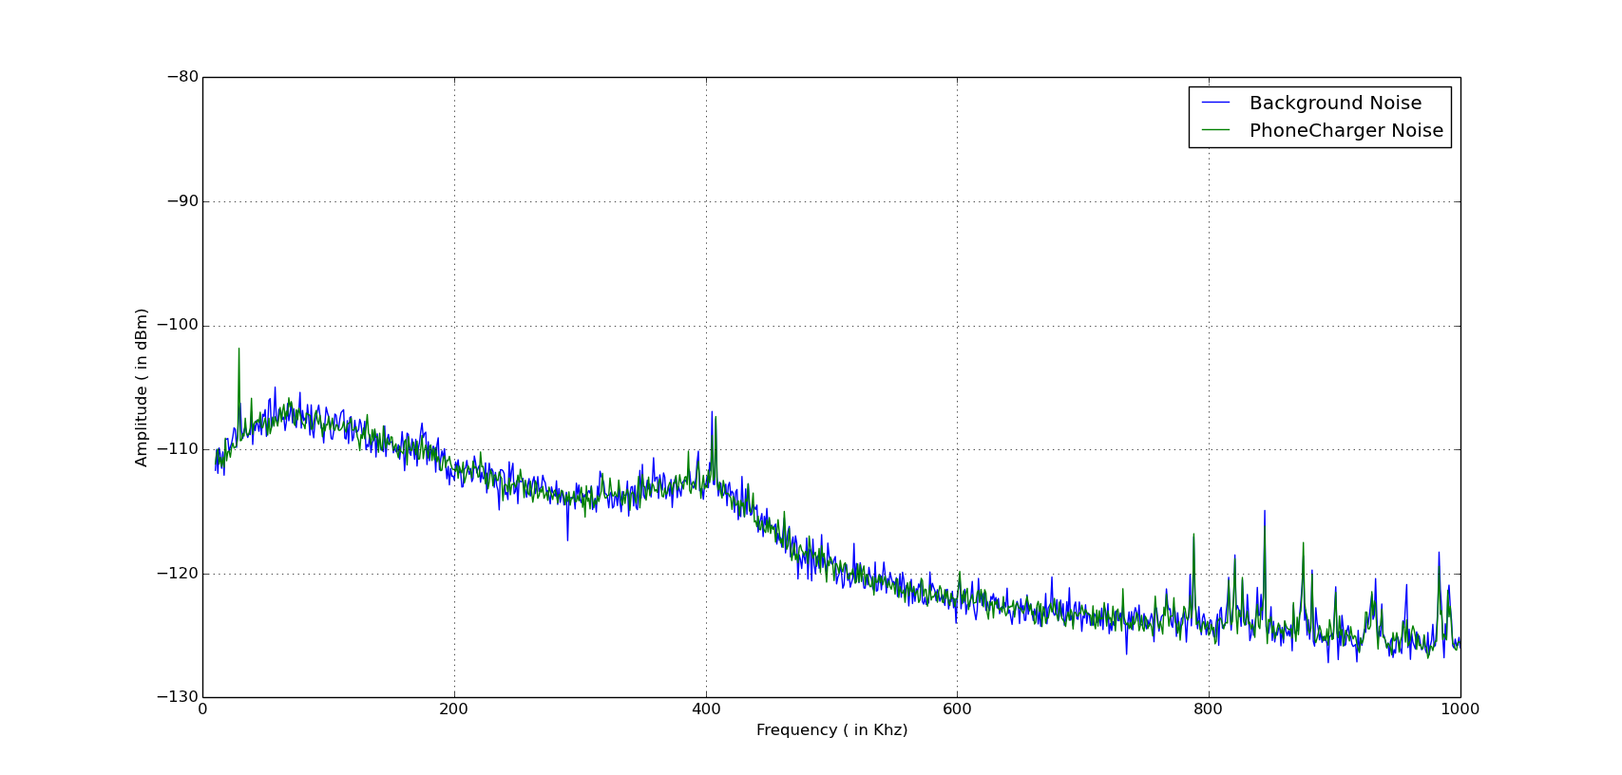
Noise from Phone charger and BGN

Slide 14
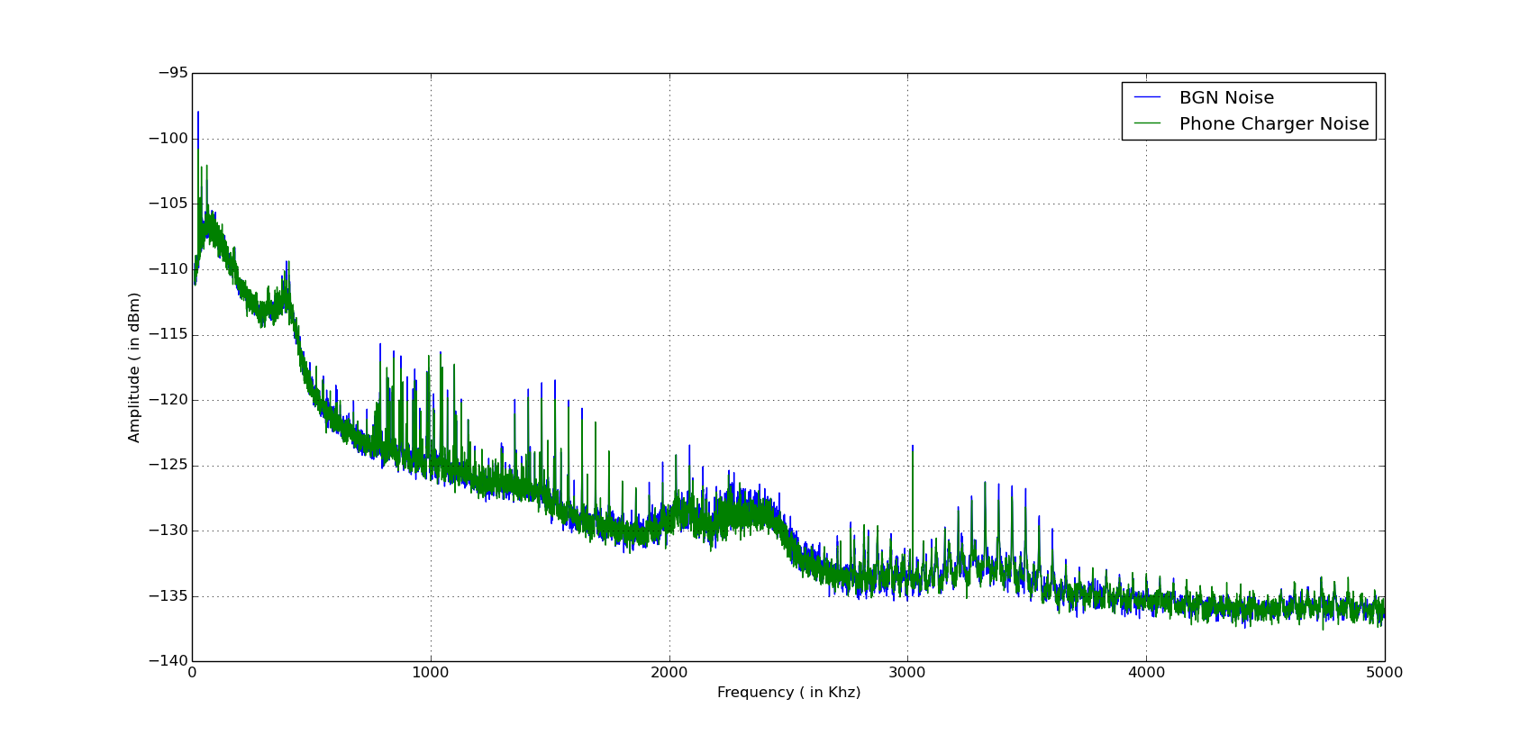
Noise from Phone charger and BGN from 10Khz-5Mhz

Slide 15
Observations
EMI noise is completely suppressed by inbuilt EMI filter in current freq. range from 10hz to 1Mhz.
Hardly any change is noticed in visible spectrum.

Slide 16
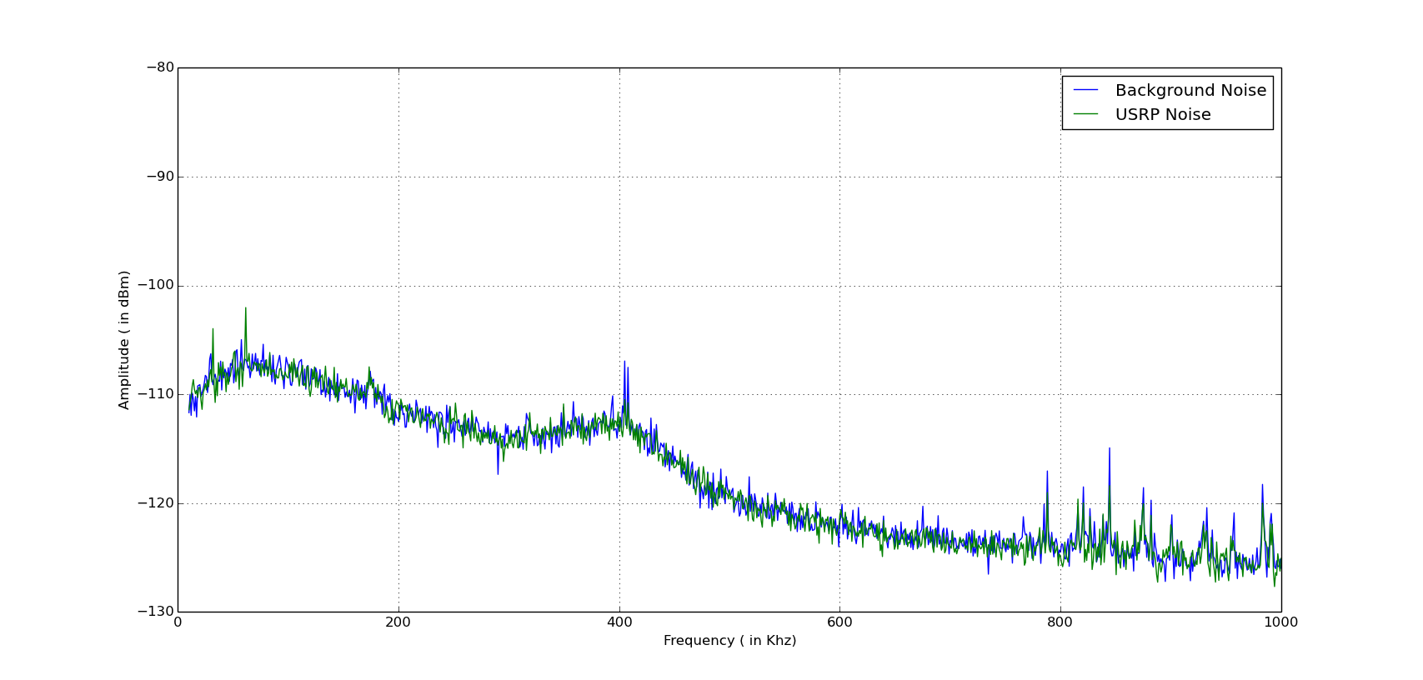
Noise from USRP and BGN

Slide 17
Observations
EMI noise is completely suppressed by inbuilt EMI filter in current freq. range from 10hz to 1Mhz.
Hardly any change is noticed in visible spectrum.

Slide 18
Noise from CFL and BGN

Slide 19
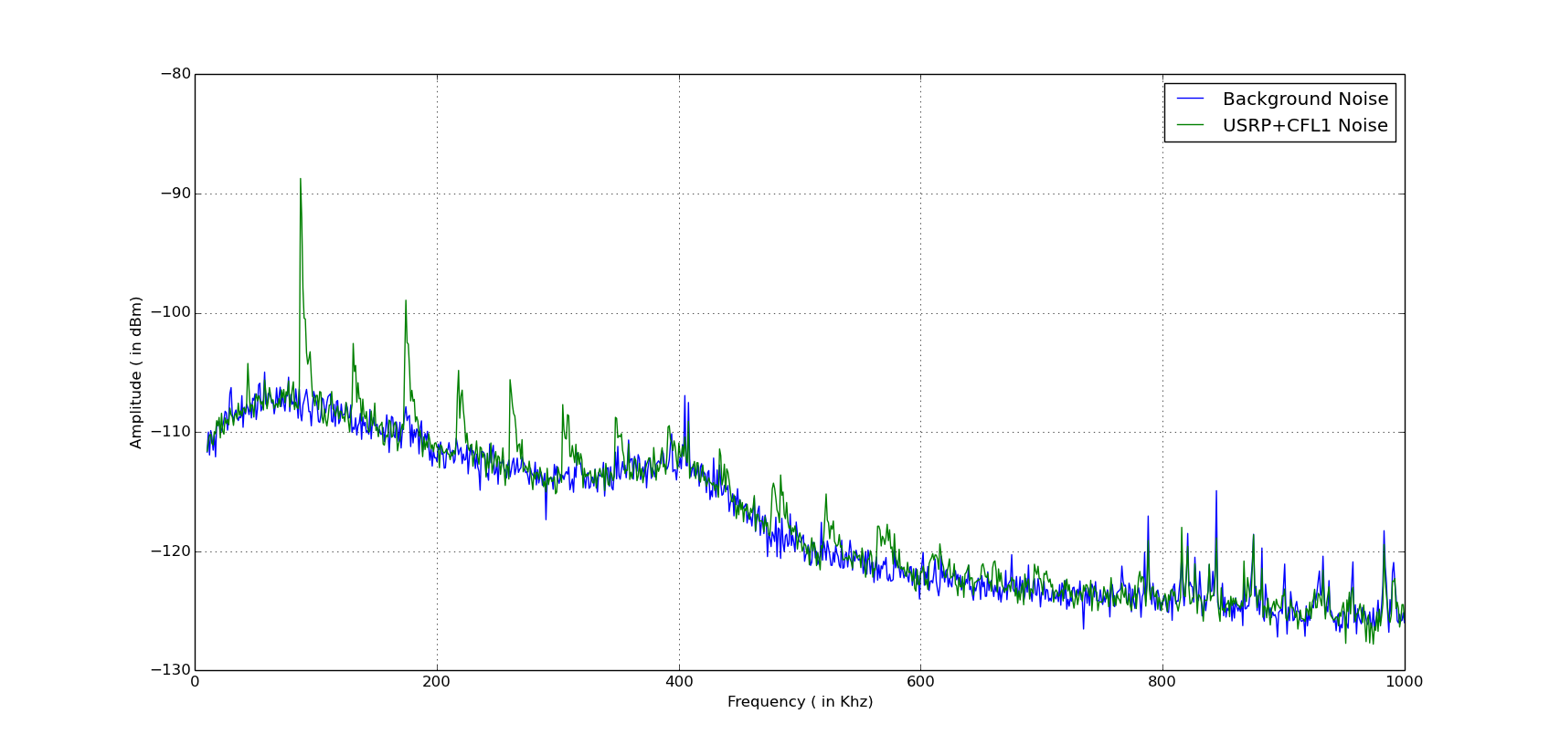
Noise from USRP+CFL1 and BGN

Slide 20
Observations
Current combination of USRP and CFL gave some nice results.
For ease of comparison same trace of CFL is copied above.
Amplitude of EMI noise(CFL) from 100KHz to 1Mhz is reduced by 15dB and at some points by 10dB.
In higher frequency range from 650Khz to 1Mhz hardly anything is visible almost whole noise spectrum is suppressed.

Slide 21
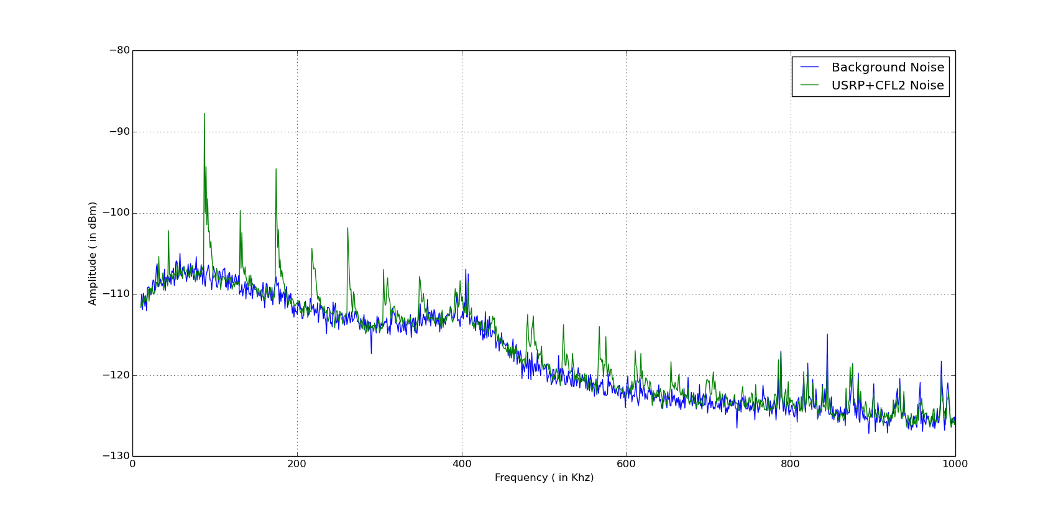
Noise from USRP+CFL2 and BGN

Slide 22
Observations
Same as previous one took another trace after some time to validate results.

Slide 23
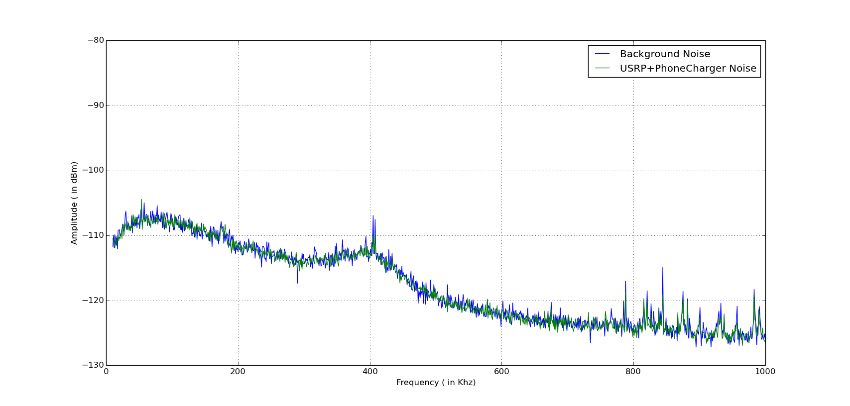
Noise from USRP+Phonecharger and BGN

Slide 24
Observations
EMI noise is completely suppressed by inbuilt EMI filter in current freq. range from 10hz to 1Mhz.
Hardly any change is noticed in visible spectrum.

Slide 25
Noise from CFL and BGN

Slide 26
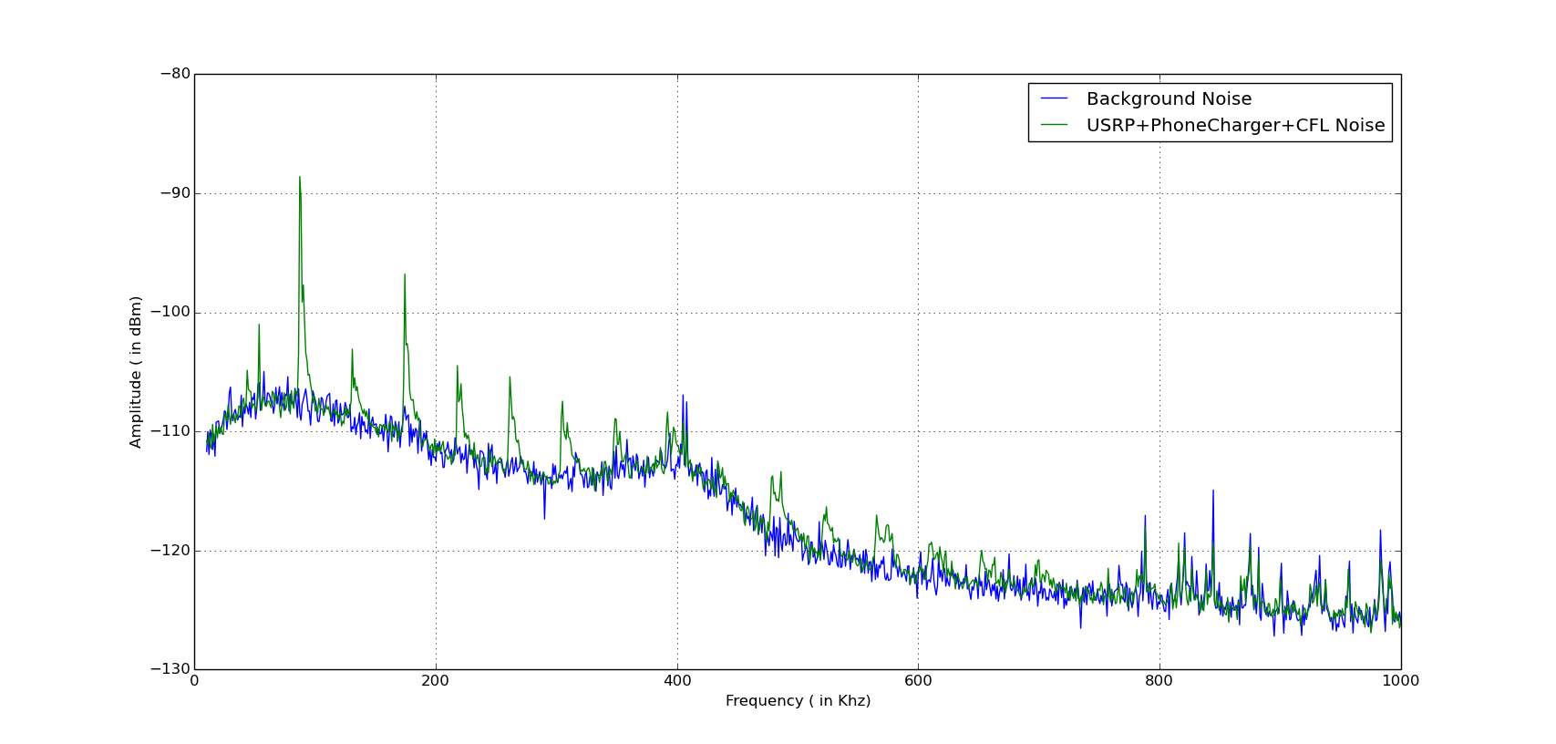
Noise from USRP+Phonecharger+CFL and BGN

Slide 27
Observations
Current combination of USRP and CFL gave some nice results.
For ease of comparison same trace of CFL is copied above.
Amplitude of EMI noise(CFL) from 100KHz to 1Mhz is reduced by 8dB and at some points by 10dB.
In higher frequency range above 700Khz hardly anything is visible almost whole noise spectrum is suppressed.
One interesting change was in freq. range less than 100Khz EMI noise from CFL was increased by 5dB.

Slide 28
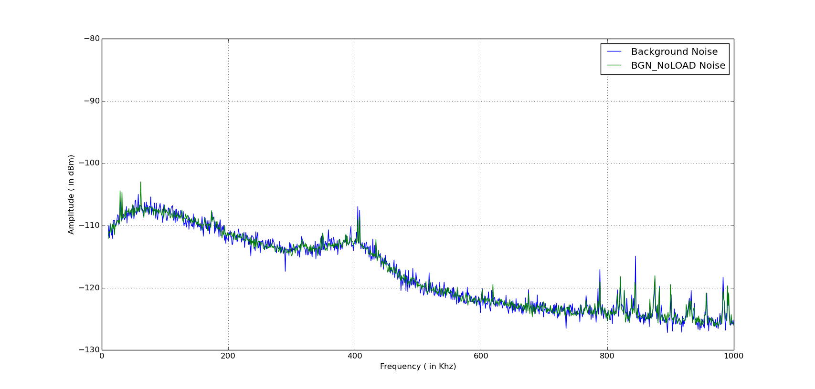
BGN taken at two different time intervals

Slide 29
Observations
Two traces of Background noise were taken to check consistency of noise as we are comparing noise with BGN in all plots.
Above results show that both the traces fairly overlap eachother and BGN is consistent with time.

Slide 30
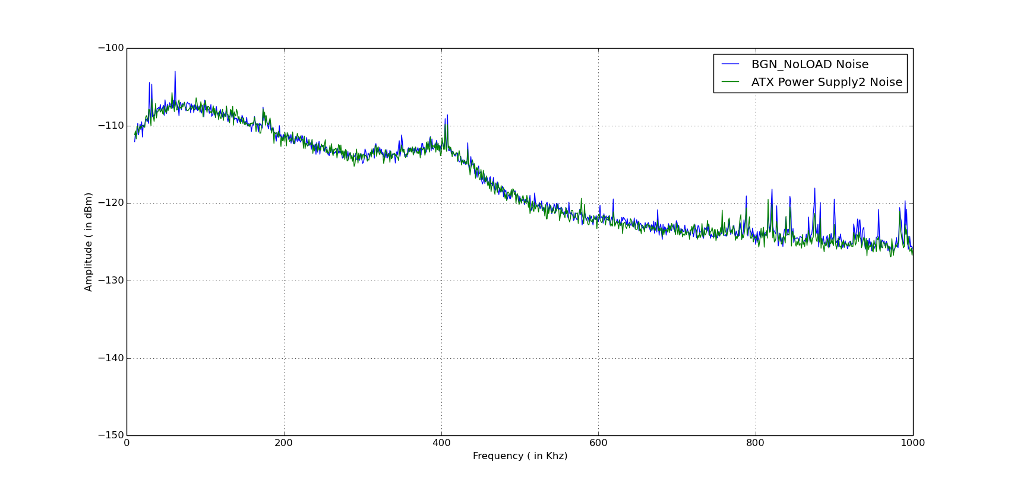
Noise from ATX power supply and BGN

Slide 31
Observations
EMI noise is completely suppressed by inbuilt EMI filter in current freq. range from 10hz to 1Mhz.
Only some noise spikes have shown increase in amplitude in the visible spectrum.

Slide 32
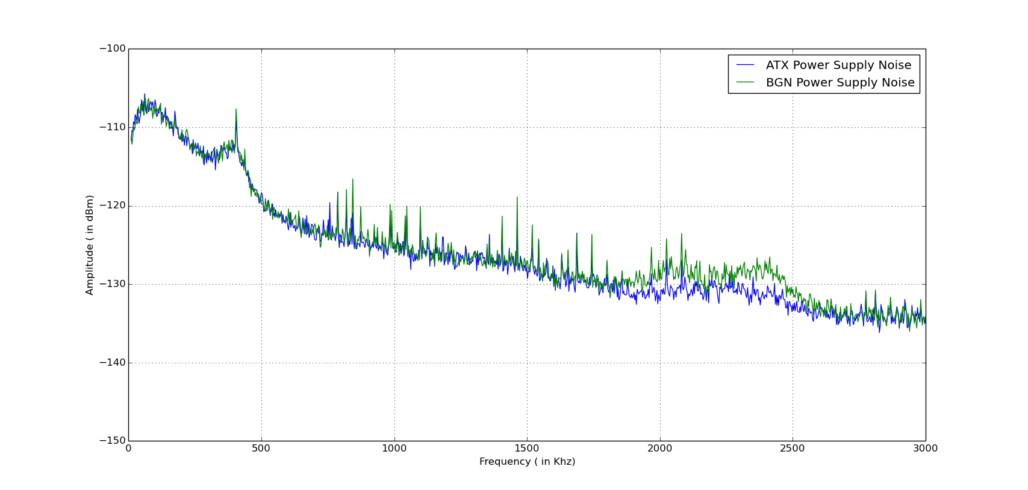
Noise from ATX power supply and BGN from 10Khz-3Mhz

Slide 33
Observations
EMI noise is showed up when observation range was modified to 10hz to 3Mhz earlier upper limit was 1Mhz.
Some noise spikes have shown increase in amplitude from 600Khz to 1.75Mhz.
A nice change is visible in freq. range from 1.75Mhz to 2.75Mhz with a amplitude of roughly 3-4dB.

Slide 34
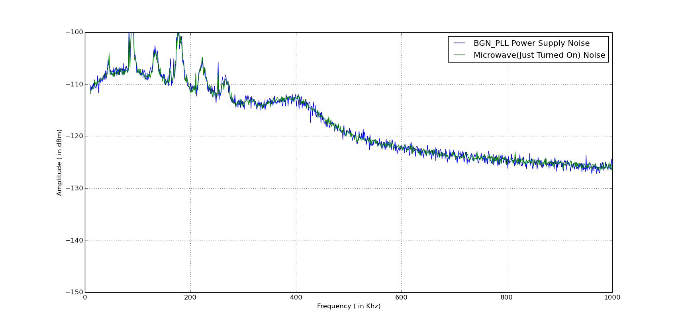
Noise from Microwave(Turned on) and BGN

Slide 35
Observations
EMI noise is completely suppressed by inbuilt EMI filter in current freq. range from 10hz to 1Mhz.
Hardly any change is noticed in visible spectrum.

Slide 36
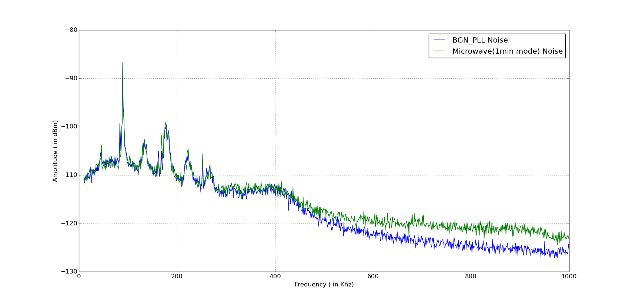
Noise from Microwave(1min mode) and BGN

Slide 37
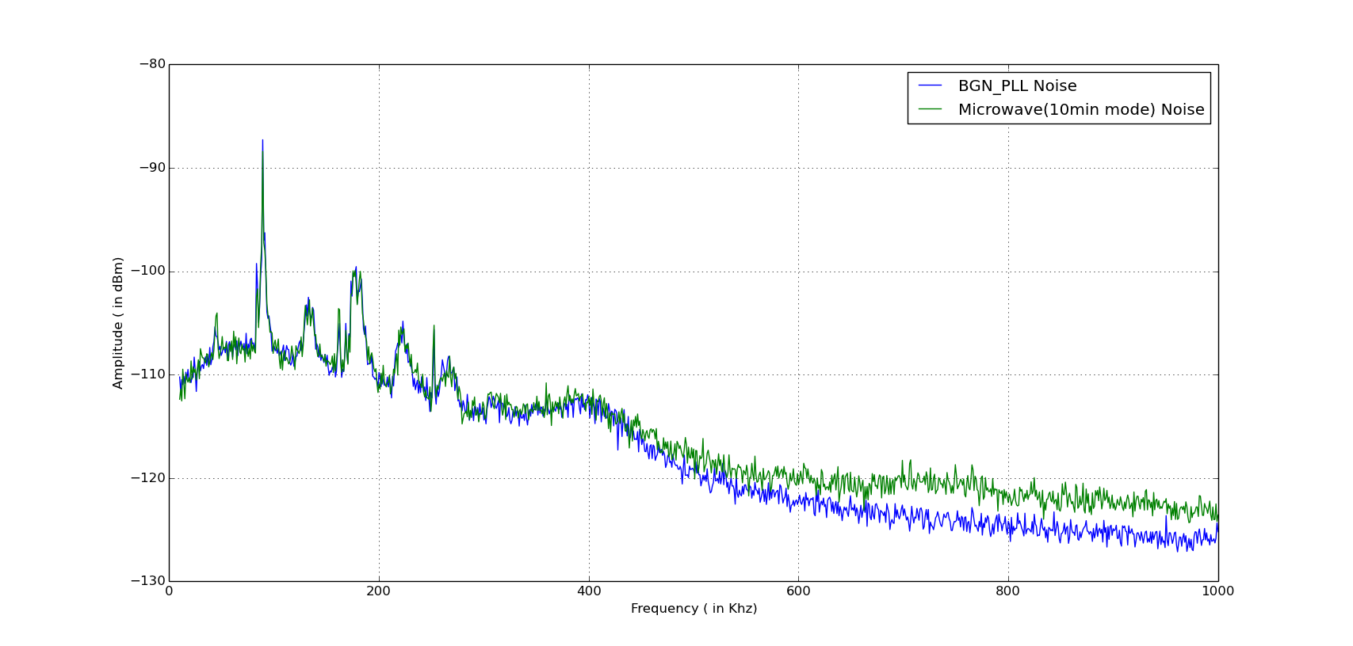
Noise from Microwave(10min mode) and BGN

Slide 38
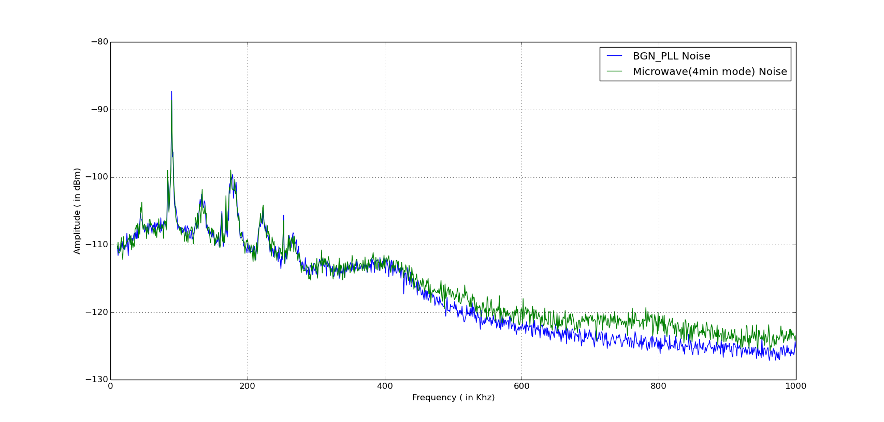
Noise from Microwave(4min mode) and BGN

Slide 39
Observations
EMI noise taken from 3 operational modes of Microwave has shown a small but noticeable change in freq. range 400Khz to 1Mhz roughly 2-3dB.

Slide 40
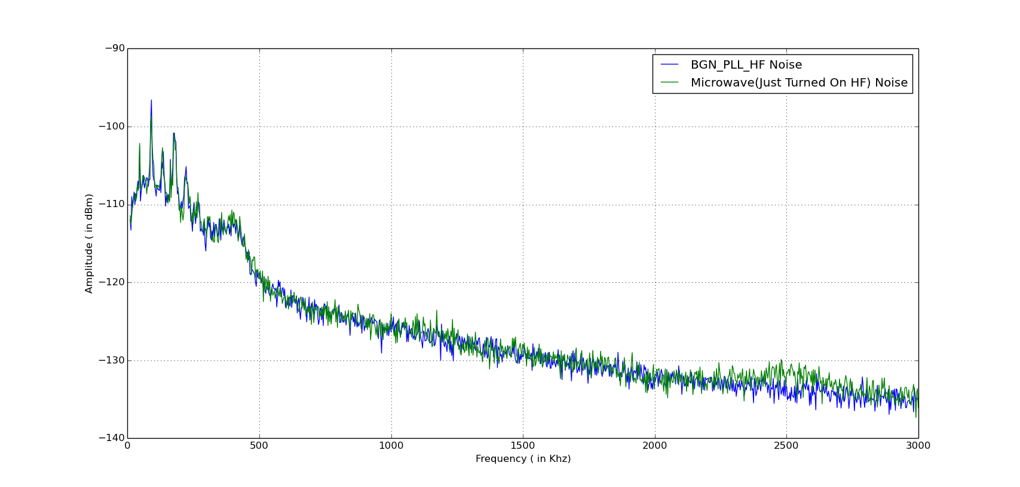
Noise from Microwave(Turned on) and BGN from 10Khz-3Mhz

Slide 41
Observations
EMI noise shows a small change from 2.25Mhz to 2.75Mhz roughly around 2-3dB.
Earlier in while observing in 10Khz to 1Mhz range their was hardly any noticeable change.

Slide 42
Noise from Microwave(Turned on) and BGN from 10Khz-3Mhz

Slide 43
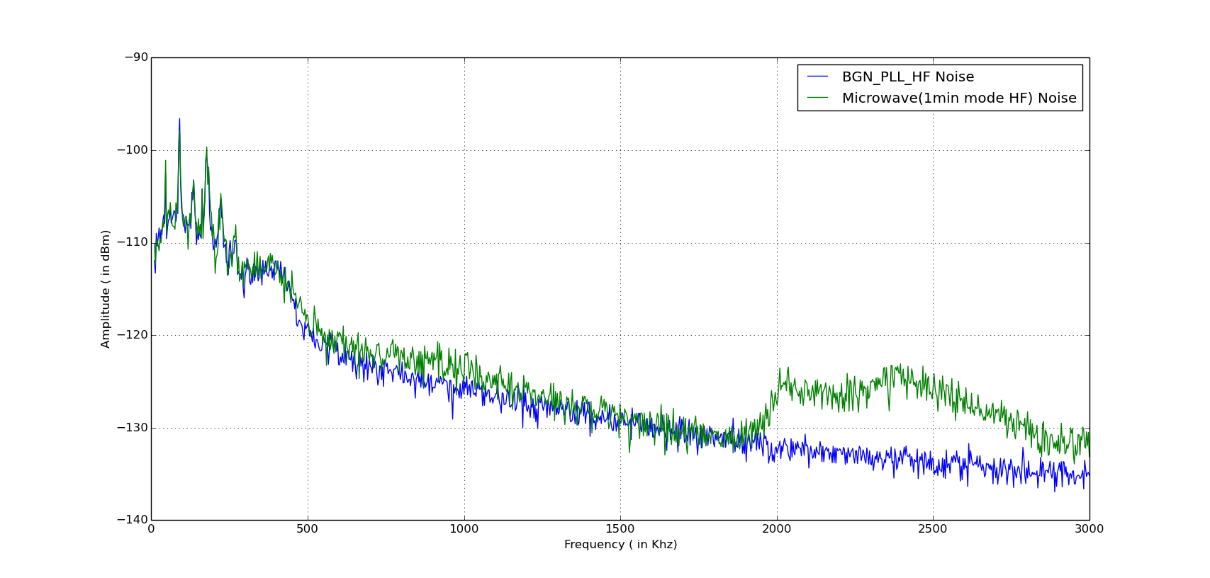
Noise from Microwave(1min mode) and BGN from 10Khz-3Mhz

Slide 44
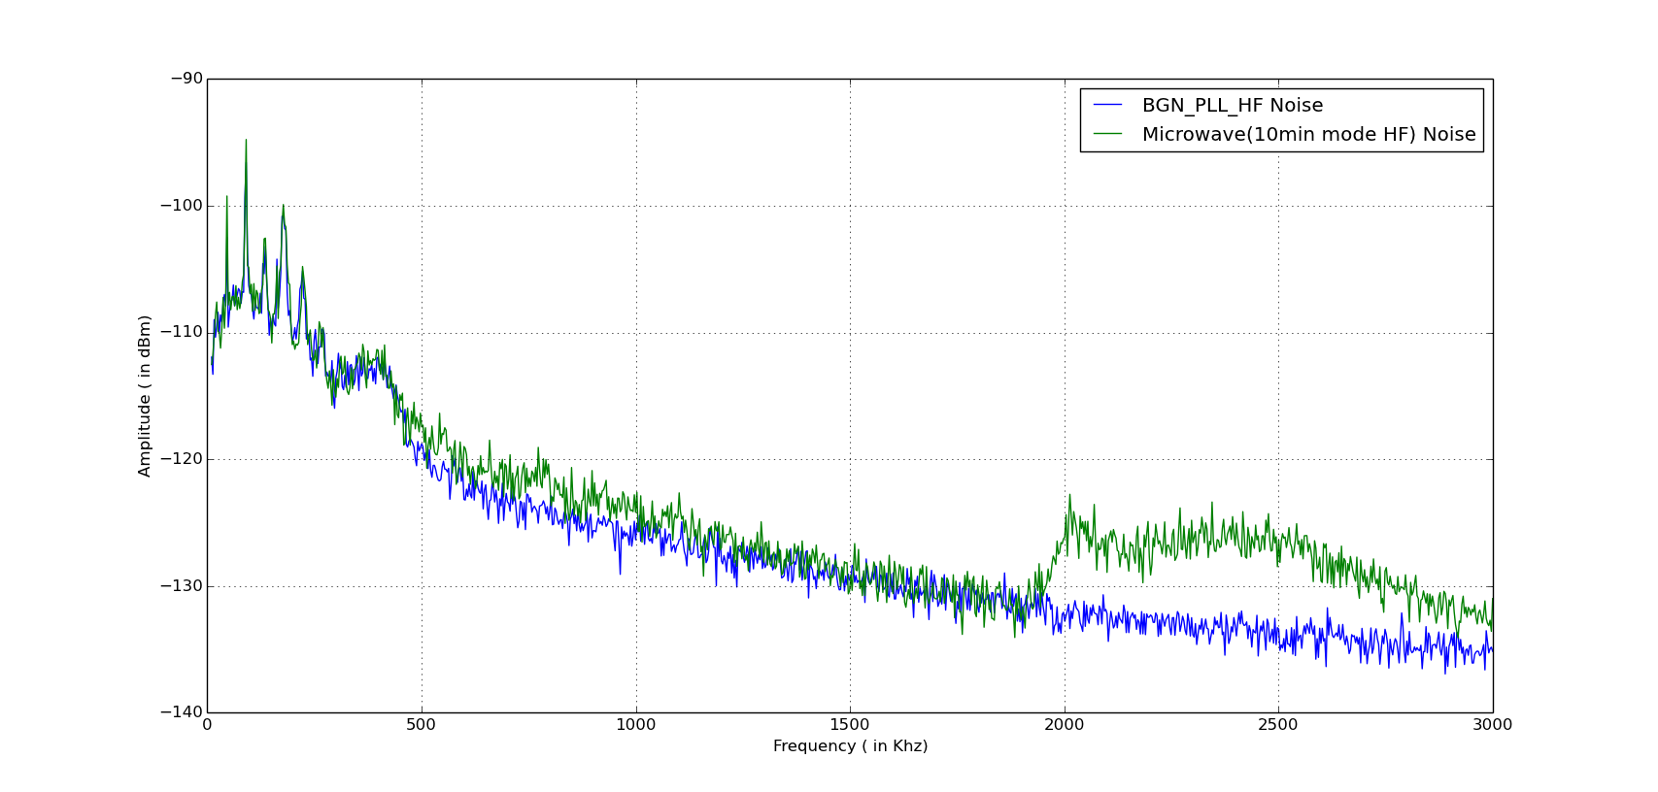
Noise from Microwave(10min mode) and BGN from 10Khz-3Mhz

Slide 45
Observations
EMI noise taken from 2 operational modes of Microwave has shown a significant change in freq. range 1.8Mhz to 3Mhz compared to just turned on state of microwave.
Compared to both operational states even there is a small change in amplitude when operational in 10min mode then to 1 min mode in the same frequency spectrum.

Slide 46
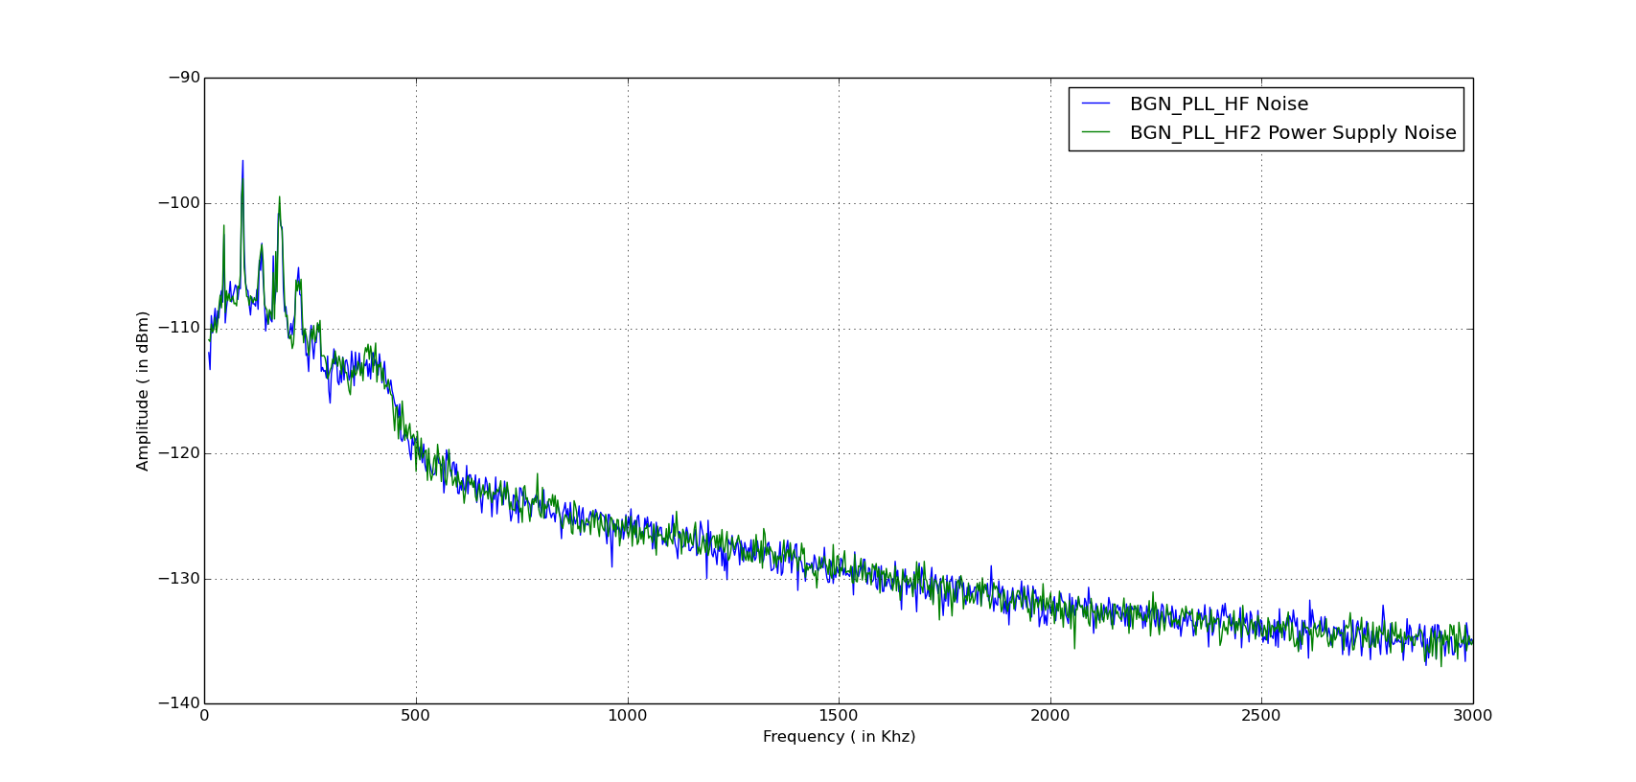
BGN taken at two different time intervals from 10Khz-3Mhz

